Slide 1
Setup Adobe creative cloud and Dreamweaver
Plus Protocols and Font kits

Slide 2
Step 1 – Install and setup Adobe creative Cloud and Dreamweaver
Install Adobe creative Cloud (if you do not already have it installed)
Sign in with your account (this account will only exist while you are at Dominic College)
Start the install process for Dreamweaver
Although you may have access to all the apps to install, be aware you don’t have the room on your student laptop to do so…..

Slide 3
Step 2 – Pre-setup Dreamweaver and install GIT
Install Git with all the default setting (this is mandatory, else Git will not function inside Dreamweaver)
Open Git CMD and enter this text
git config --global http.sslVerify false

Slide 4
Step 3 – Setup your local site location (or re-establish your local site)
Select ‘manage site’ in the menu under ‘site’
Create a new site

Slide 5
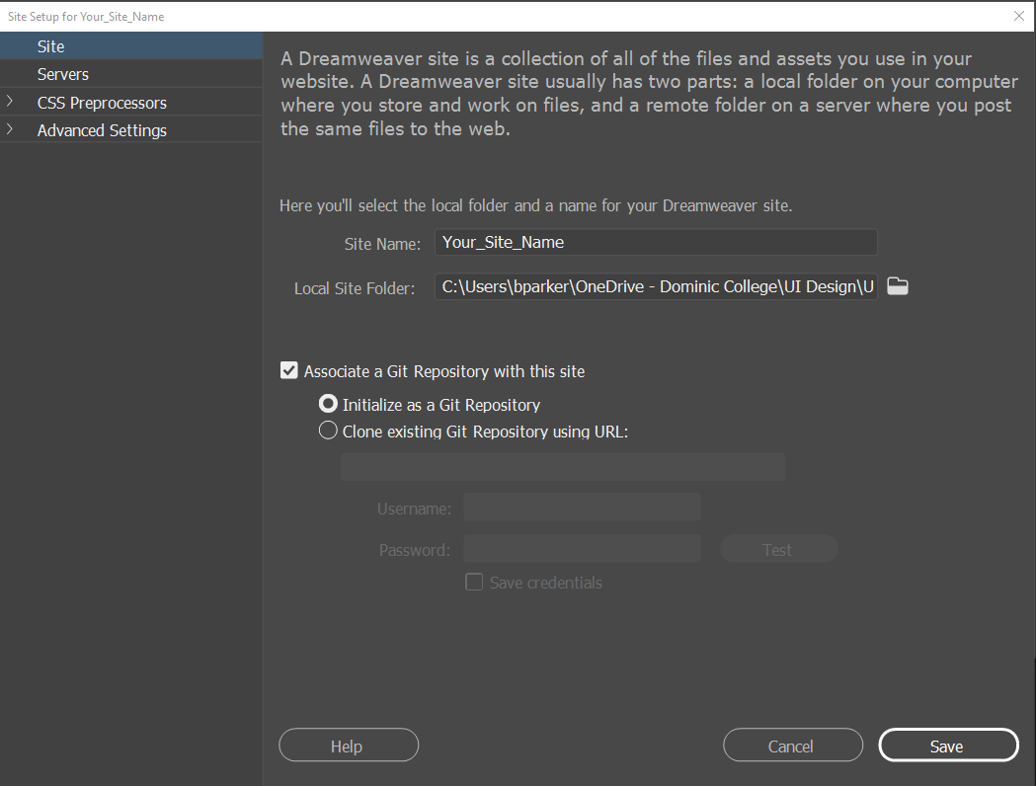
New Site Creation
Give you Site a relevant name
Chose a locale folder
This can be OneDrive
Tick associate a Git and leave it as initialize as a Git Repo
Click ‘Save’
In the Window menu select ‘Git’

Slide 6
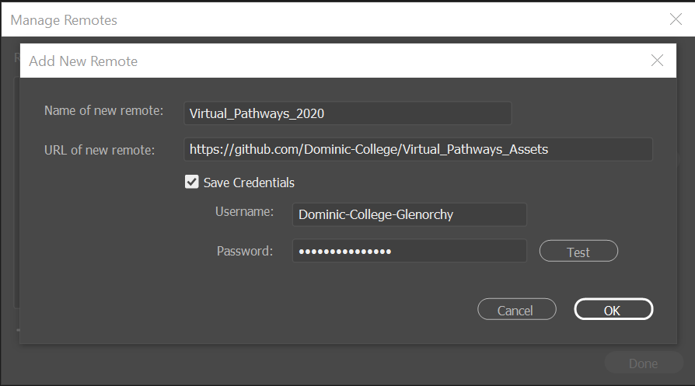
Link GitHub
In the Git panel at the bottom right, click on ‘Manage remotes’
This is where you make the link to your GitHub Repo.
Copy from GitHub the URL address into the URL line.
Add your GitHub Username and password then ‘Test’
If OK then OK to continue

Slide 7
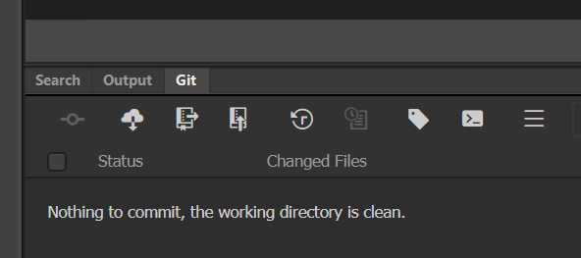
What do I see?

